Slide 1
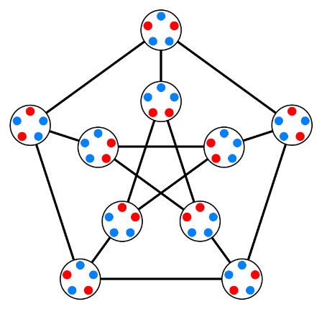
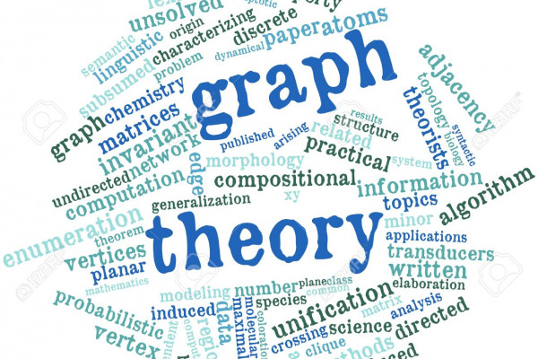
Graph Theory Basics
Mr. Asim Raza
Email: asim.raza@ucp.edu.pk

Slide 2
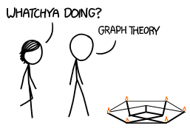

Graphs $G(V,E)$

Slide 3
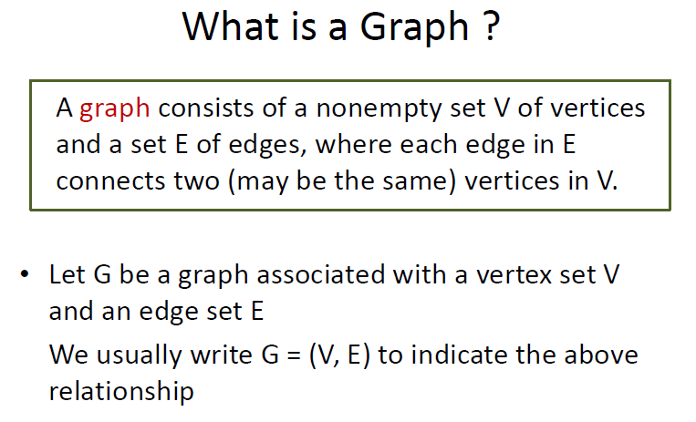
Basics of Graph Theory

Slide 4
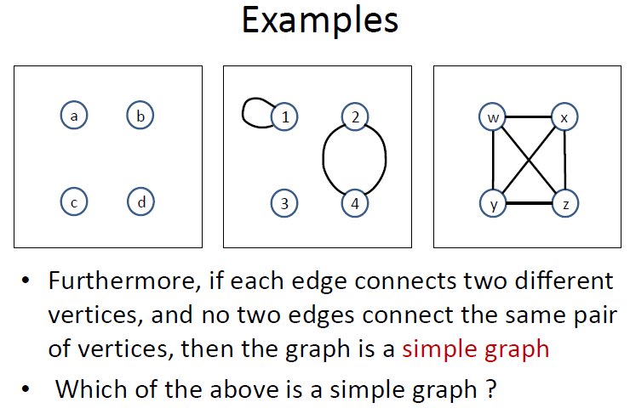
Basics of Graph Theory

Slide 5
Basics of Graph Theory
Terminology (Directed Graph)
Sometimes we want to specify a direction on each edge
Example: Vertices may represent cities, and edges may represent roads (can be one-way)
This gives directed graph as follows:
A directed graph G consists of a non empty set V of vertices and a set E of directed edges, where each edge is associated with an ordered pair of vertices. We write G=(V,E) to denote graph.

Slide 6
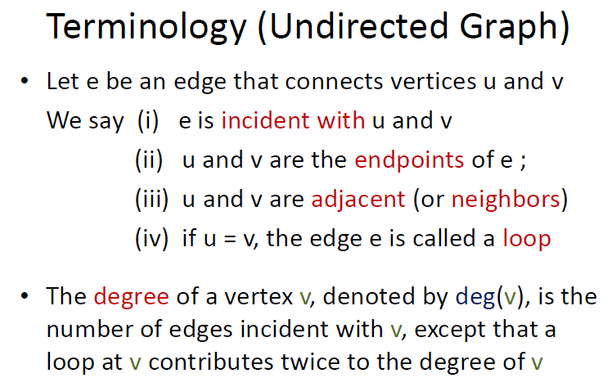
Basics of Graph Theory

Slide 7
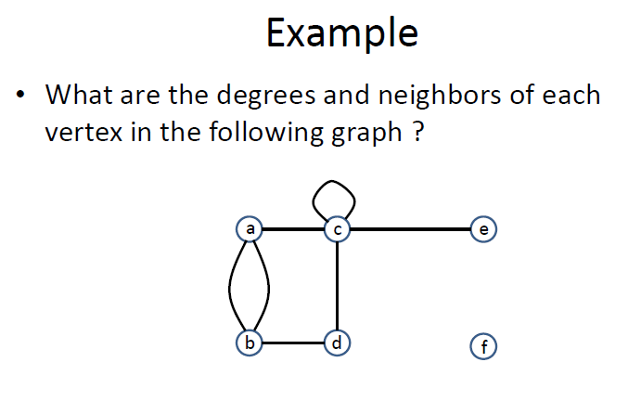
Basics of Graph Theory

Slide 8
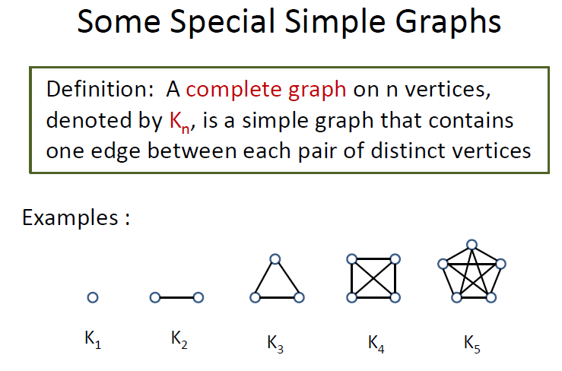
Basics of Graph Theory

Slide 9
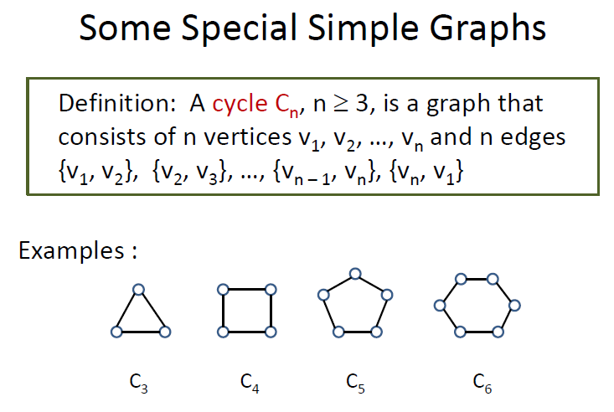
Basics of Graph Theory

Slide 10
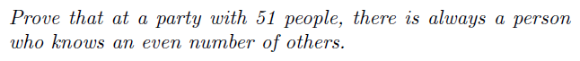
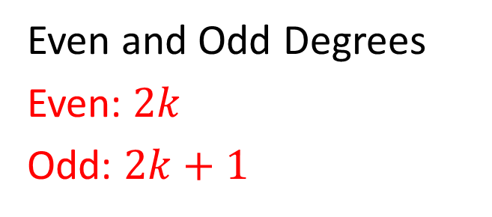
Basics of Graph Theory
Even and Odd Degrees
Even: $2k$
Odd: $2k+1$

Slide 11
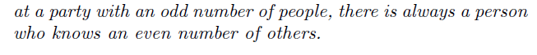


Basics of Graph Theory
Even and Odd Degrees

Slide 12
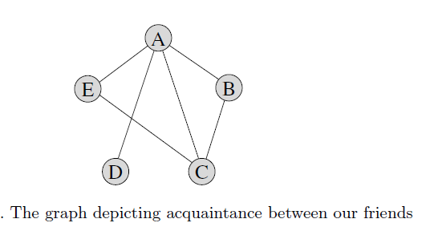
Basics of Graph Theory
Even and Odd Degrees
Suppose we have 5 friends:
Alice, Bob, Carl, Diane, Eve

Slide 13
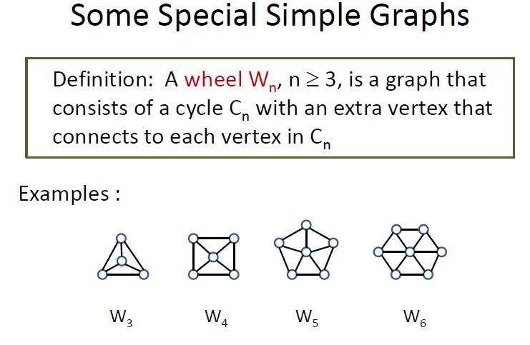
Basics of Graph Theory

Slide 14
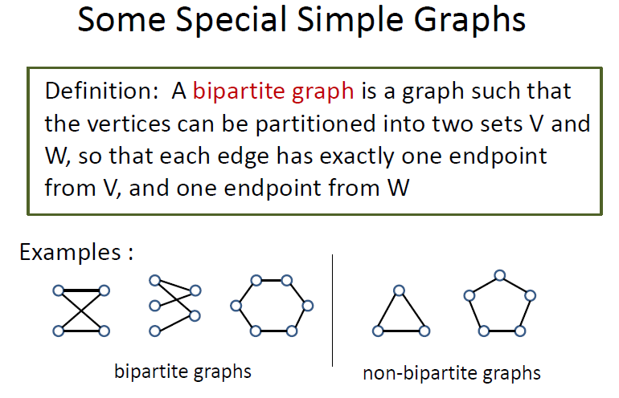
Basics of Graph Theory

Slide 15
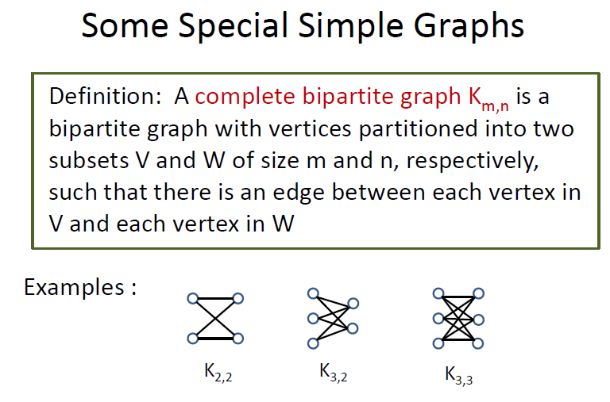
Basics of Graph Theory

Slide 16
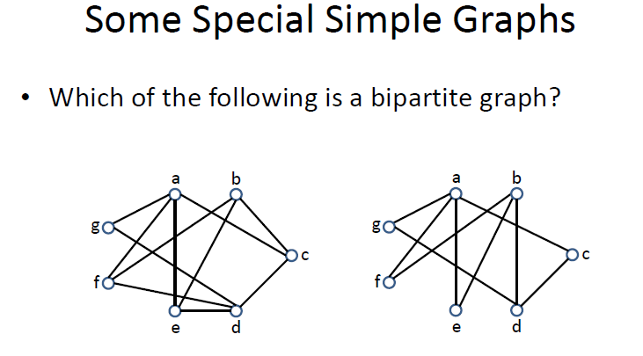
Basics of Graph Theory

Slide 17
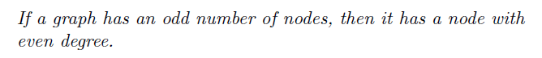
Basics of Graph Theory
Even and Odd Degrees

Slide 18
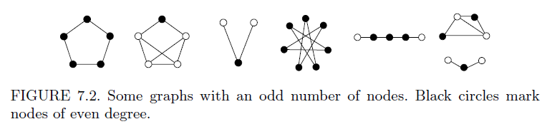
Basics of Graph Theory
Even and Odd Degrees

Slide 19
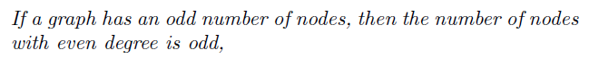

Basics of Graph Theory
Even and Odd Degrees
Even: $2k$
Odd: $2k+1$

Slide 20
Basics of Graph Theory
Even and Odd Degrees
This implies
If a graph has an odd number of nodes,
then the number of nodes with odd degree is even
Because
Odd + Even = Odd
|Even degree nodes| + |Odd degree nodes| = |Total nodes|

Slide 21
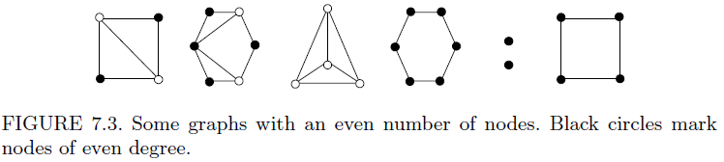
Basics of Graph Theory
Even and Odd Degrees

Slide 22
Basics of Graph Theory
Even and Odd Degrees
This implies
If a graph has an even number of nodes, then the number of nodes with odd degree is even
Because
Even + Even = Even
|Even degree nodes| + |Odd degree nodes| = |Total nodes|

Slide 23
Basics of Graph Theory
Even and Odd Degrees

Slide 24
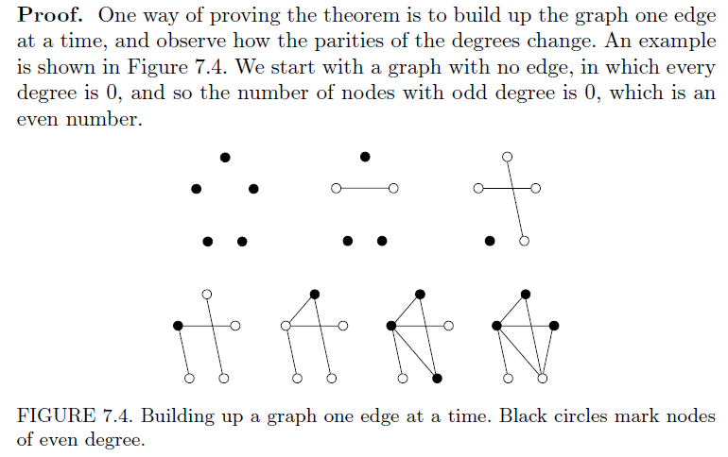
Basics of Graph Theory
Proof

Slide 25
Basics of Graph Theory
Proof

Slide 26
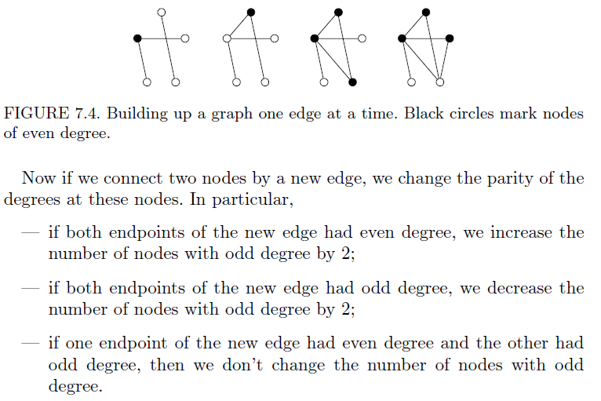
Basics of Graph Theory
Proof
|Odd-Degree Nodes| = Even
Even + 2 = Even

Slide 27
Basics of Graph Theory
Proof
|Odd-Degree Nodes| = Even
Even – 2 = Even

Slide 28
Basics of Graph Theory
Proof
|Odd-Degree Nodes| = Even
Odd + 1 = Even
Even + 1 = Odd

Slide 29
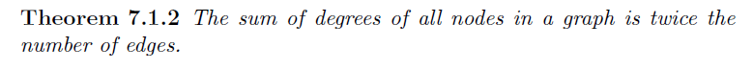
Basics of Graph Theory
Even and Odd Degrees

Slide 30
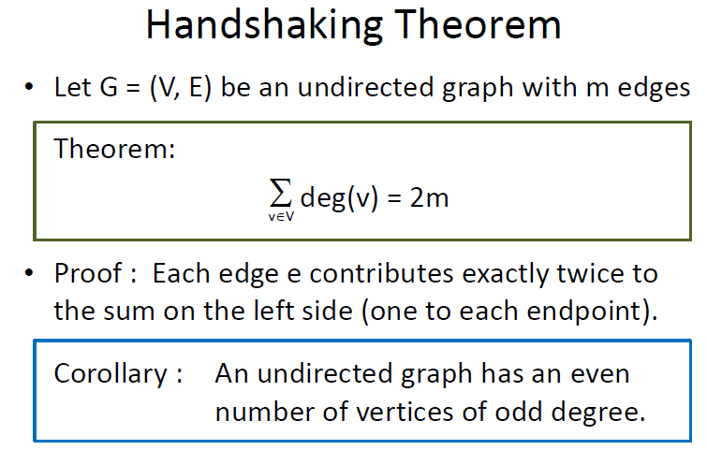
Basics of Graph Theory

Slide 31
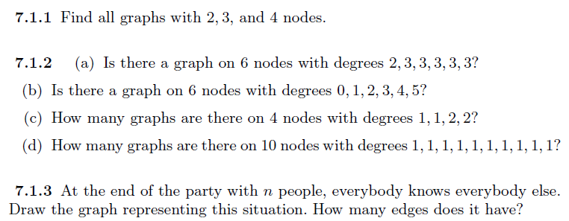
Practice Problems Try to solve at your own

Slide 32
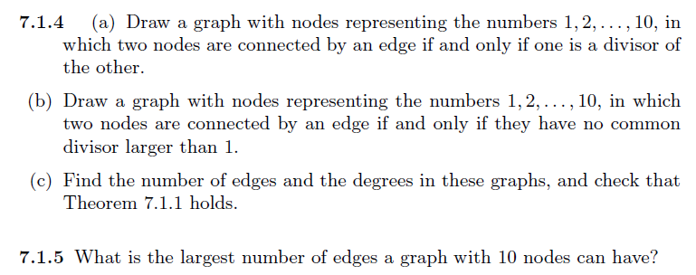
Practice Problems Try to solve at your own

Slide 33
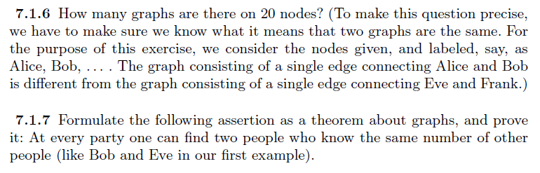
Practice Problems Try to solve at your own

Slide 34
Graphs Paths, Cycles and Connectivity

Slide 35
Paths and Cycles (Section 7.2 of textbook)
Paths
Cycles

Slide 36
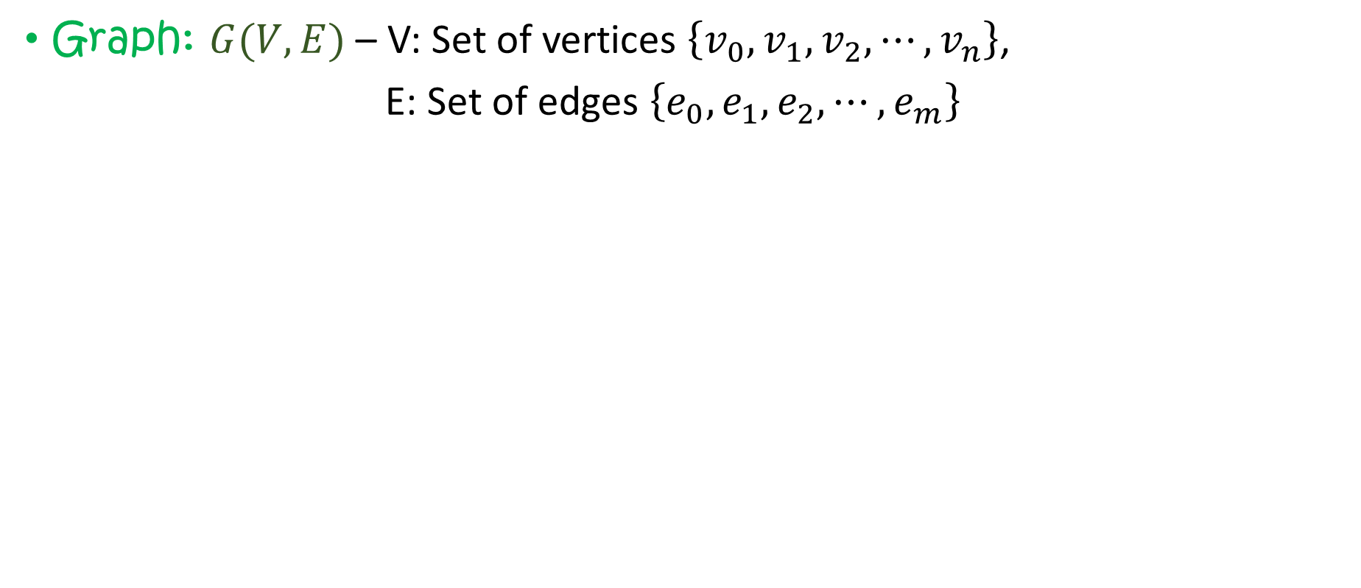
Recap
Graph: $G(V,E)$ – V: Set of vertices $\left\{v_{0},v_{1},v_{2},⋯, v_{n}\right\}$,
E: Set of edges $\left\{e_{0},e_{1},e_{2},⋯, e_{m}\right\}$

Slide 37

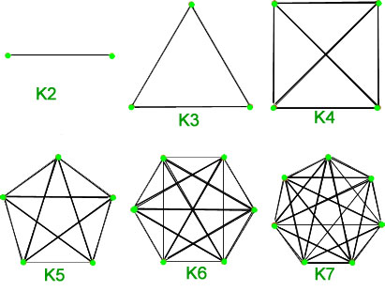
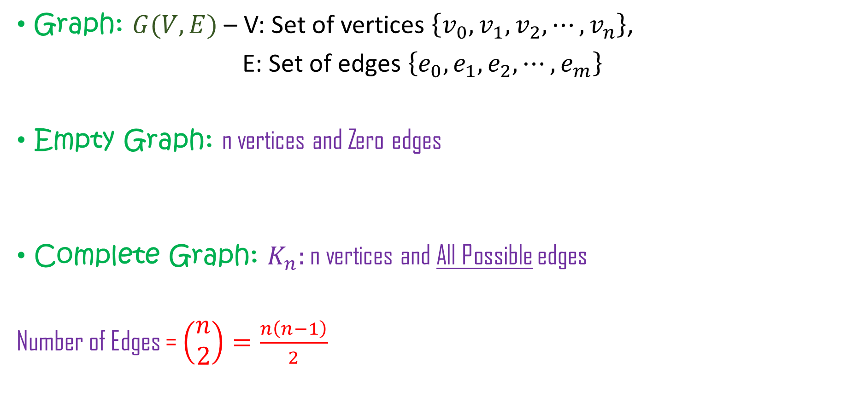
Recap
Graph: $G(V,E)$ – V: Set of vertices $\left\{v_{0},v_{1},v_{2},⋯, v_{n}\right\}$,
E: Set of edges $\left\{e_{0},e_{1},e_{2},⋯, e_{m}\right\}$
Empty Graph: n vertices and Zero edges
Complete Graph: $K_{n}:$ n vertices and All Possible edges
Number of Edges = $\left(\begin{aligned}n \\ 2\end{aligned}\right)=\frac{n\left(n−1\right)}{2}$

Slide 38
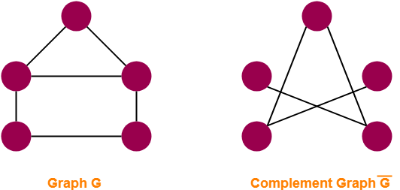
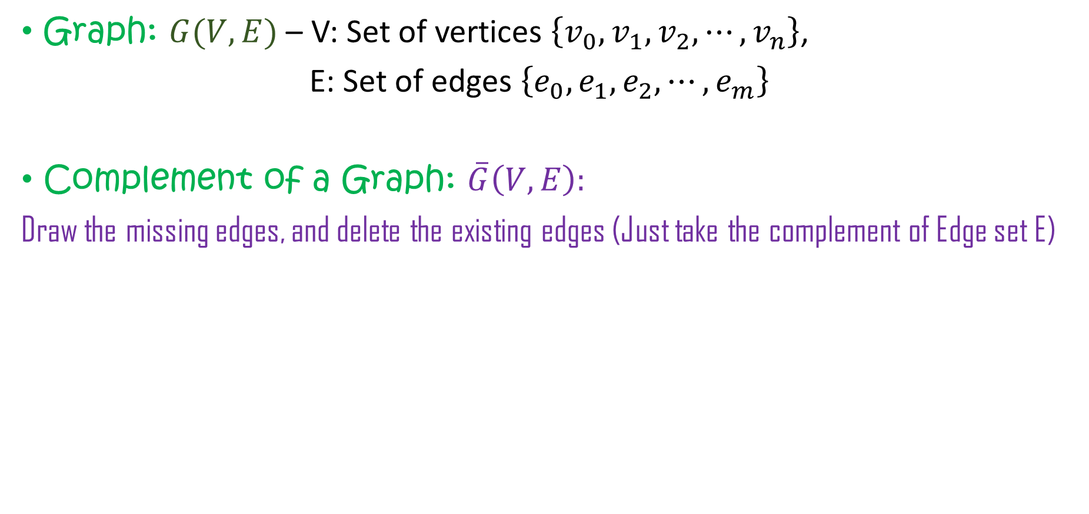
Recap
Graph: $G(V,E)$ – V: Set of vertices $\left\{v_{0},v_{1},v_{2},⋯, v_{n}\right\}$,
E: Set of edges $\left\{e_{0},e_{1},e_{2},⋯, e_{m}\right\}$
Complement of a Graph: $\overline{G}\left(V,E\right):$
Draw the missing edges, and delete the existing edges (Just take the complement of Edge set E)

Slide 39
Recap
Graph: $G(V,E)$ – V: Set of vertices $\left\{v_{0},v_{1},v_{2},⋯, v_{n}\right\}$,
E: Set of edges $\left\{e_{0},e_{1},e_{2},⋯, e_{m}\right\}$
Complement of a Graph: $\overline{G}\left(V,E\right):$
Draw the missing edges, and delete the existing edges (Just take the complement of Edge set E)

Slide 40
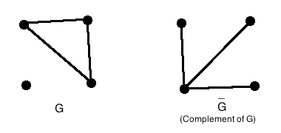
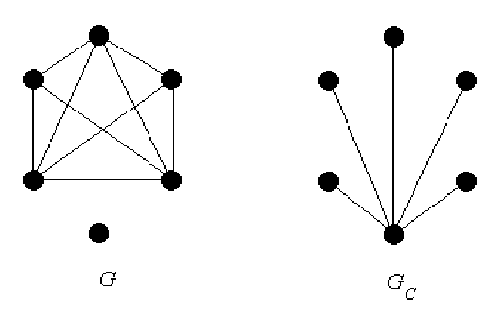
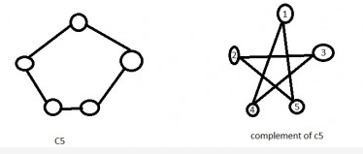
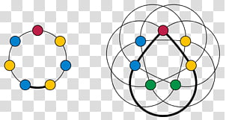
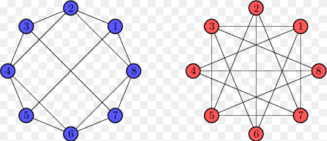
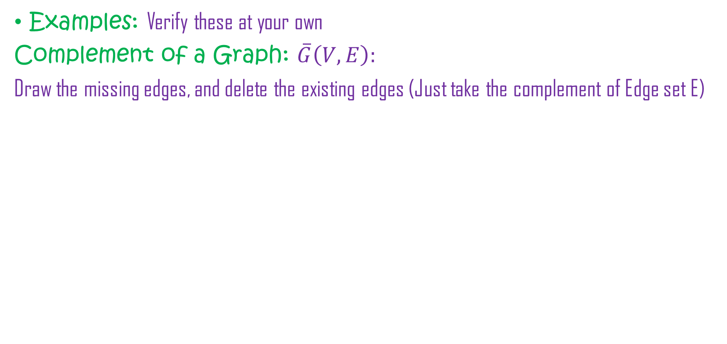
Recap
Examples: Verify these at your own
Complement of a Graph: $\overline{G}\left(V,E\right):$
Draw the missing edges, and delete the existing edges (Just take the complement of Edge set E)

Slide 41
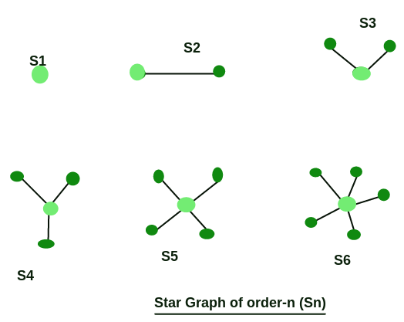
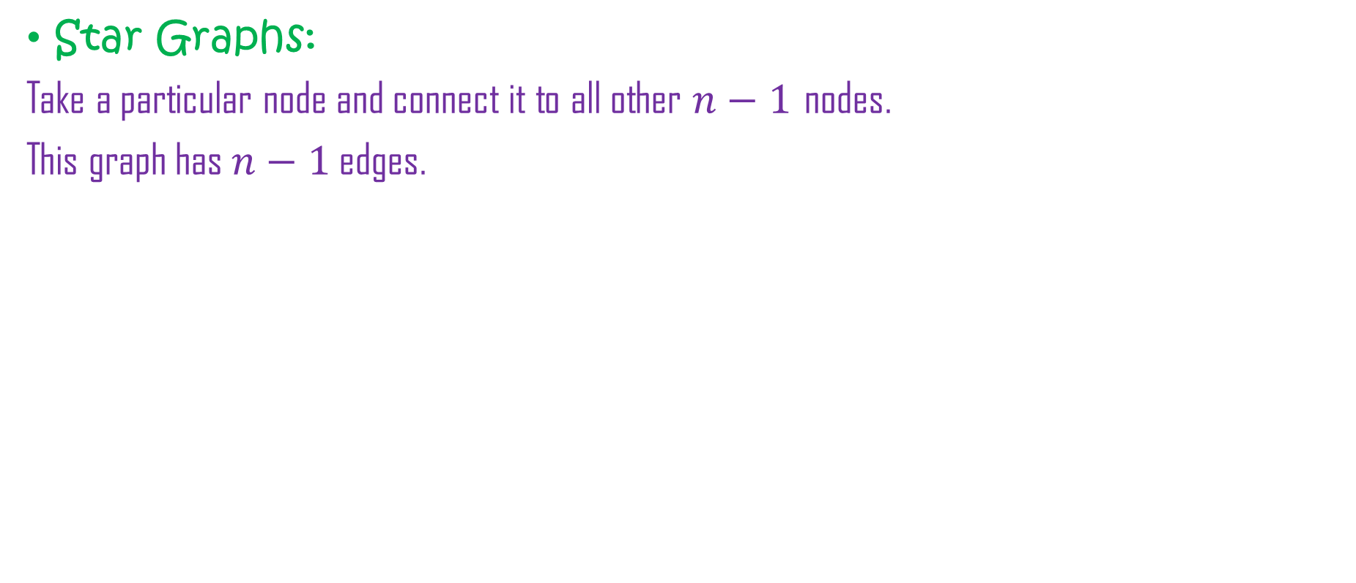
Recap
Star Graphs:
Take a particular node and connect it to all other $n−1$ nodes.
This graph has $n−1$ edges.

Slide 42
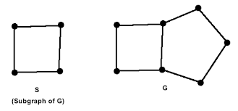
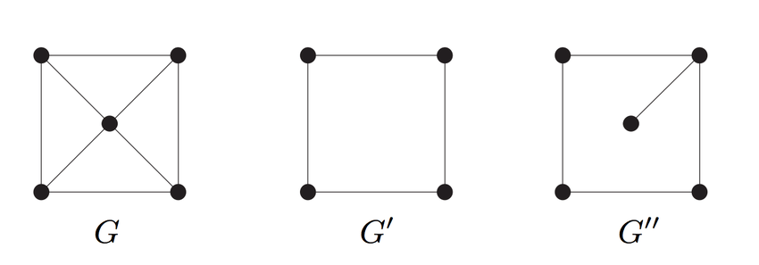
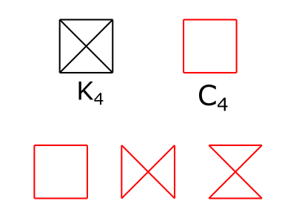
Recap
SubGraphs:
Take any part of the graph – it will be Subgraph of the Graph (just like subset of a set)

Slide 43
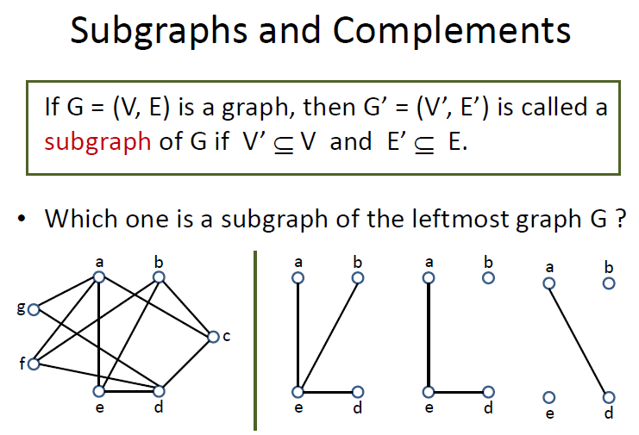
Basics of Graph Theory

Slide 44
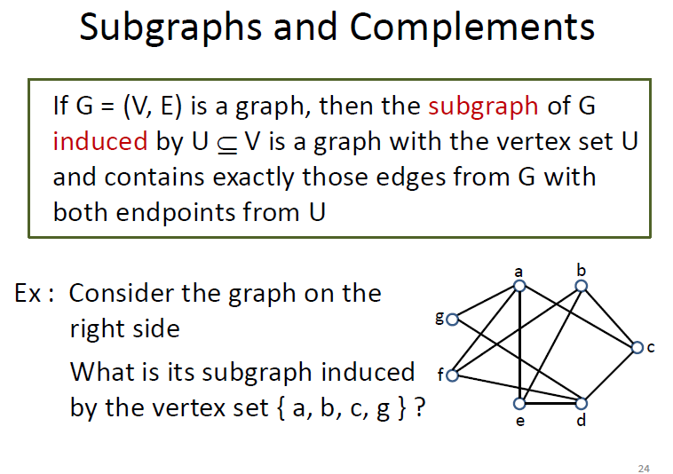
Basics of Graph Theory

Slide 45
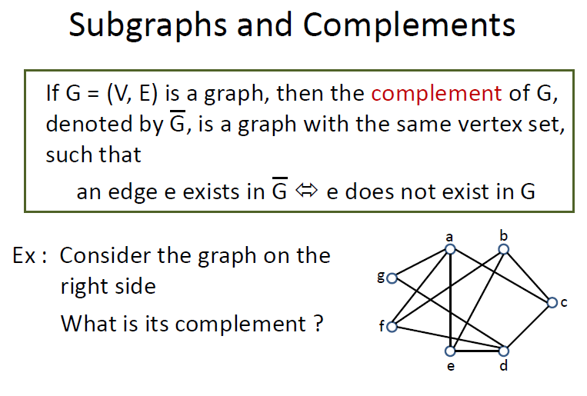
Basics of Graph Theory

Slide 46
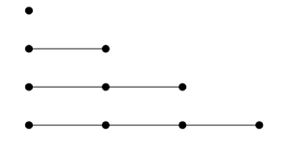
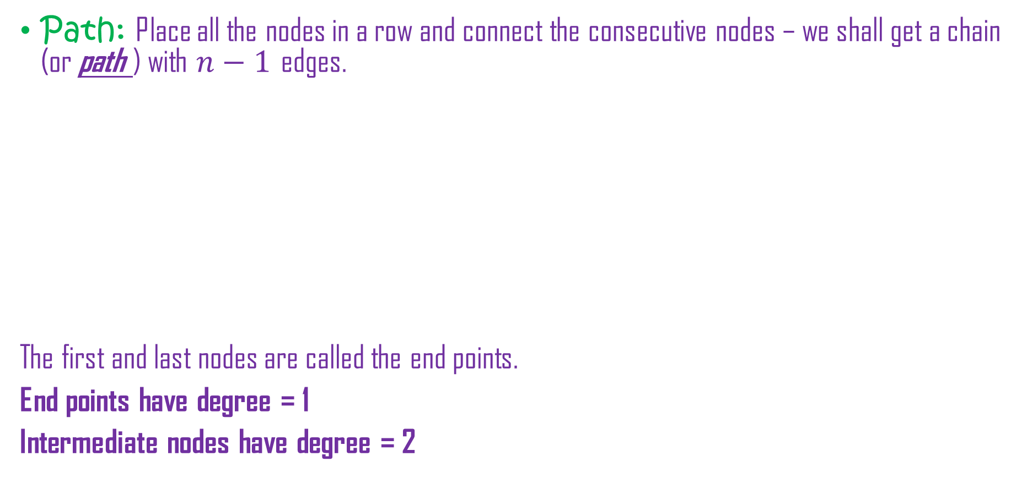
Paths and Cycles (Section 7.2 of textbook)
Path: Place all the nodes in a row and connect the consecutive nodes – we shall get a chain (or path ) with $n−1$ edges.
The first and last nodes are called the end points.
End points have degree = 1
Intermediate nodes have degree = 2

Slide 47
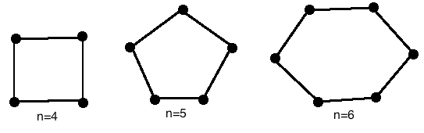

Paths and Cycles (Section 7.2 of textbook)
Path: Place all the nodes in a row and connect the consecutive nodes – we shall get a chain (or path ) with $n−1$ edges.
If we also connect the first and last node – we complete a circular path – it is called CYCLE.

Slide 48


Paths and Cycles (Section 7.2 of textbook)
Path: Place all the nodes in a row and connect the consecutive nodes – we shall get a chain (or path ) with $n−1$ edges.
If we also connect the first and last node – we complete a circular path – it is called CYCLE.
We may draw same graph in many ways

Slide 49

Paths and Cycles (Section 7.2 of textbook)
Connected Graph: If every two nodes in the graph are connected by a path.
We can reach from any node $a$ to a node $b$, following a path.

Slide 50

Paths and Cycles (Section 7.2 of textbook)
Connected Graph: If every two nodes in the graph are connected by a path.
We can reach from any node $a$ to a node $b$, following a path.

Slide 51
Paths and Cycles (Section 7.2 of textbook)
Connected Graph: If every two nodes in the graph are connected by a path.
We can reach from any node $a$ to a node $b$, following a path.
Bridge: if we remove this edge, the graph becomes disconnected

Slide 52

Paths and Cycles (Section 7.2 of textbook)
Example:
Connected Graphs on 5 nodes

Slide 53

Paths and Cycles (Section 7.2 of textbook)
Walk: A walk in a graph $G$ is a sequence of nodes $v_{0},v_{1},⋯, v_{n}$ which are connected by edges in the given sequence.
It is just like a PATH where nodes may be REPEATED.

Slide 54


Paths and Cycles (Section 7.2 of textbook)
Walk: A walk in a graph $G$ is a sequence of nodes $v_{0},v_{1},⋯, v_{n}$ which are connected by edges in the given sequence.
It is just like a PATH where nodes may be REPEATED.
For example:

Slide 55

Paths and Cycles (Section 7.2 of textbook)
Walk: A walk in a graph $G$ is a sequence of nodes $v_{0},v_{1},⋯, v_{n}$ which are connected by edges in the given sequence.
It is just like a PATH where nodes may be REPEATED.
For example:

Slide 56

Paths and Cycles (Section 7.2 of textbook)
Walk: A walk in a graph $G$ is a sequence of nodes $v_{0},v_{1},⋯, v_{n}$ which are connected by edges in the given sequence.
It is just like a PATH where nodes may be REPEATED.
For example:

Slide 57

Eulerian Walk and Hamiltonian Cycles
(Section 7.3 of textbook)
Eulerian Walk: A walk in a graph $G$ such that each edge is visited ONLY ONCE.

Slide 58

Seven Bridges of Königsberg
Eulerian Walk and Hamiltonian Cycles
(Section 7.3 of textbook)
Cross each of seven bridges once and return back to starting point.

Slide 59

Seven Bridges of Königsberg
Eulerian Walk and Hamiltonian Cycles
(Section 7.3 of textbook)
Cross each of seven bridges once and return back to starting point.
Let’s make graph of the problem. Replace LAND by NODES and BRIDGES by EDGES, connecting the lands.

Slide 60


Let’s Re-draw it: … and the Eulerian Trail
Eulerian Walk and Hamiltonian Cycles
(Section 7.3 of textbook)
Cross each of seven bridges once and return back to starting point.
Eulerian Trail/Path: In a graph G, there is a closed path which traverse each edge ONLY ONCE and returns back to the starting point. ➔ such graph is called Eulerian Graph.

Slide 61
Eulerian Graph
(Section 7.3 of textbook)
Eulerian Graph: A graph containing Eulerian Path
5
1
6
4
9
2
3
8
10
12
7
11

Slide 62
Eulerian Graph
(Section 7.3 of textbook)
Eulerian Graph: A graph containing Eulerian Path
Eulerian Graph
Semi-Eulerian Graph
Non-Eulerian Graph

Slide 63
Eulerian Graph
(Section 7.3 of textbook)
Which graph is an Eulerian Graph ?
Eulerian Graph
Semi-Eulerian Graph
Non-Eulerian Graph

Slide 64
Eulerian Graph
(Section 7.3 of textbook)
Which graph is an Eulerian Graph ?
Lemma: If in a graph G, every vertex has a degree at least 2, then G contains a cycle.
Eulerian Graph

Slide 65
Eulerian Graph
(Section 7.3 of textbook)
Which graph is an Eulerian Graph ?
Lemma: If in a graph G, every vertex has a degree at least 2, then G contains a cycle.
Theorem (Euler, 1736): A connected graph G is Eulerian if and only if the degree of each vertex is even.
Proof: ☺
Eulerian Graph

Slide 66
Eulerian Graph
(Section 7.3 of textbook)
Which graph is an Eulerian Graph ?
Lemma: If in a graph G, every vertex has a degree at least 2, then G contains a cycle.
Theorem (Euler, 1736): A connected graph G is Eulerian if and only if the degree of each vertex is even.
Proof: ☺
Semi-Eulerian: if and only if it has exactly
two vertices of odd degree.
Eulerian Graph

Slide 67
Eulerian Graph
(Section 7.3 of textbook)
Theorem (Euler, 1736): A connected graph G is Eulerian if and only if the degree of each vertex is even.
Proof: ☺
How to construct: Fleury’s Algorithm:
Eulerian Graph

Slide 68
Eulerian Graph: Fleury’s Algorithm
Eulerian Graph
(Section 7.3 of textbook)
How to construct:

Slide 69
Eulerian Graph: Fleury’s Algorithm
Eulerian Graph
(Section 7.3 of textbook)
Try with these:

Slide 70

Try this

Slide 71

Eulerian Graph: Fleury’s Algorithm
Eulerian Graph
(Section 7.3 of textbook)
Try with these: Seven Bridges of Königsberg

Slide 72
Eulerian Graph: Fleury’s Algorithm
Eulerian Graph
(Section 7.3 of textbook)
Try with these: Seven Bridges of Königsberg
NOT SOLVABLE

Slide 73

Exercises
Eulerian Graph
(Section 7.3 of textbook)

Slide 74

Exercises
Eulerian Graph
(Section 7.3 of textbook)

Slide 75

Exercises
Eulerian Graph
(Section 7.3 of textbook)

Slide 76

Eulerian Walk and Hamiltonian Cycles
(Section 7.3 of textbook)
Hamiltonian Cycle: A cycle in a graph $G$ such that each NODE is visited ONLY ONCE.

Slide 77
Hamiltonian Graph
Hamiltonian Cycle: In a graph G, there is a closed path which traverse each vertex ONLY ONCE and returns back to the starting point. ➔ such graph is called Hamiltonian Graph.

Slide 78

Hamiltonian Graph
Hamiltonian Cycle: In a graph G, there is a closed path which traverse each vertex ONLY ONCE and returns back to the starting point. ➔ such graph is called Hamiltonian Graph.
Semi-Hamiltonian Graph
Non-Hamiltonian Graph
Hamiltonian Graph

Slide 79
Hamiltonian Graph
Which graphs are Hamiltonian?. ☹

Slide 80
Hamiltonian Graph
Which graphs are Hamiltonian?. ☹
Theorem (Dirac 1952):If G is a simple graph with n ≥3, and if deg(v) ≥ n/2 for each vertex v, then G is Hamiltonian.

Slide 81
Hamiltonian Graph
Which graphs are Hamiltonian?. ☹
Theorem (Dirac 1952):If G is a simple graph with n ≥3, and if deg(v) ≥ n/2 for each vertex v, then G is Hamiltonian.
Theorem (Ore 1960):If G is a simple graph with n ≥3, and if deg(v) + deg(w) ≥ n, for each pair of non-adjacent vertices v and w, then G is Hamiltonian.

Slide 82

Exercises

Slide 83
Exercises
Dodecahedron is Hamiltonian.

Slide 84


Exercises

Slide 85


Exercises
In a complete graph on $n$ nodes, $K_{n}$, how many Hamiltonian Cycles should be there?
e.g. $K_{5}$
Hamiltonian Cycles:
A-B-C-D-E-A
A-B-D-C-E-A
A-C-E-D-B-A
How many Hamiltonian Cycles: $\frac{4!}{2}$
$$\frac{\left(n−1\right)!}{2}$$

Slide 86



Practice Problems Try to solve at your own

